Slide 1
Hospital Data Management System
By William James

Slide 2
Problem
Hospitals often use paper to keep track of their records, and this is a very slow and expensive process to maintain
Data can easily get lost and it will be hard to piece back together
This can cause big problems in the hospital
Lives are on the line

Slide 3
Solution
Create a simple and efficient hospital data management system application to save the hospital time and money
Prevent data from being lost
Minimize time spent retrieving information records so more time can be spent helping patients and trying to save lives
This will make communication easier for the Doctors, staff and patients
Use proper techniques I have learned throughout the semester and researched

Slide 4
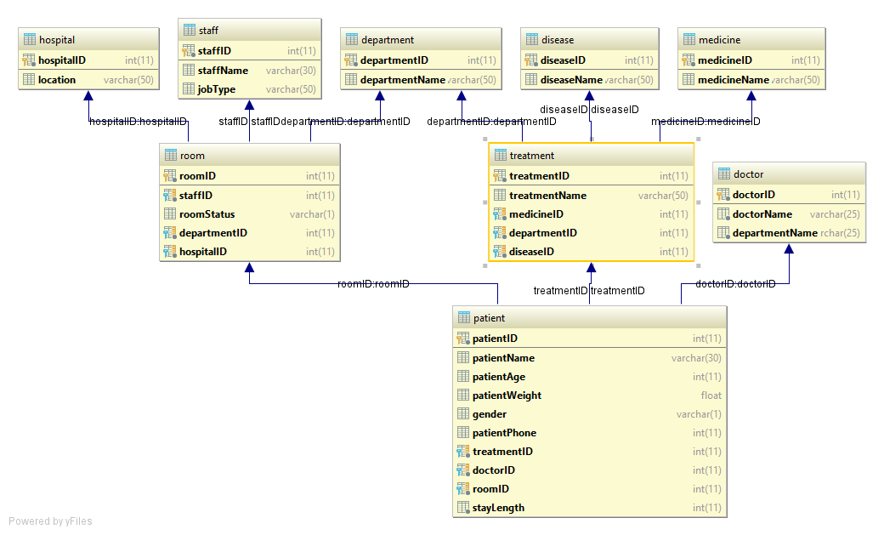
Schema Diagram

Slide 5
How It works!
Front End: JavaFX using FXML Through IntelliJ
Backend: MySQL
Hospital Management system will be able to print, search, insert, update and Delete data to and from the database
Generate reports into a csv file

